Slide 1


Final Year Project
Multi-Purpose AI Password Analysis Tool
(Offensive and Defensive AI Warfare)
Supervised By: Dr. Muhammad Mansoor Alam

Slide 2
Project Team
Salman Ali (27667)
Osama Khalid (27971)
Sardar M. Zeeshan khan (27969)

Slide 3
Table of Contents
Background and Introduction
Market Survey
Problem Statement
Project Scope
Proposed Solution
Requirements Summary
Design Summary
Methodology
Implementation Summary
Experiments and Results Summary
Testing Summary
Conclusion and Outlook

Slide 4
"The only truly secure system is one that is completely powered off, cast in concrete, and sealed in a lead-lined box buried a mile underground ."
-Bruce Schneier (Security Expert)

Slide 5
BACKGROUND AND INTRODUCTION

Slide 6
Introduction Multi-Purpose AI Password Analysis Tool
Offensive Features
Make use of password comparison and top tiered algorithms to best get over passwords within a range and only when permitted.
Defensive Features
Automatic password strength, perceived words identification, and patterns finding with AI.

Slide 7
Background
Weaknesses in password practices such as predictable patterns and human error pose significant risks.
Traditional password policies and manual security checks often fail to combat sophisticated cyberattacks.
Brute-force methods systematically guess all possible password combinations.
Highly time-consuming and computationally expensive, especially for complex passwords.

Slide 8
Stakeholders
Businesses
Security Professionals
Law Enforcement

Slide 9
MARKET SURVEY

Slide 10

Market Survey
Tools | John the Ripper | RainbowCrack | OphCrack | L0phtCrack | Aircrack-ng
Type | Password Cracker | Password Cracker | Password Cracker | Password Cracker | Wi-Fi Network Security Tool
Supported Platforms | Windows, Linux, macOS | Windows, Linux | Windows, Linux | Windows | Linux, macOS
Password Hashes Supported | Various (Unix, Windows, etc.) | LM, NTLM, MD5, SHA1, SHA256, SHA512 | LM, NTLM | LM, NTLM | WEP, WPA, WPA2
Attack Methods | Dictionary, Brute Force, Hybrid | Precomputed Hash Tables | Rainbow Tables, Brute Force | Dictionary, Brute Force | Dictionary, Brute Force, WPS PIN
Speed | Fast | Depends on Rainbow Table size | Moderate | Fast | Depends on hardware and complexity of the password
User Interface | Command Line | Command Line | GUI | GUI | Command Line
License | Open Source | Freeware | Open Source | Commercial | Open Source
Usage | Penetration Testing, Password Auditing | Password Cracking | Password Recovery | Password Cracking | Wi-Fi Network Security Testing

Slide 11
PROBLEM STATEMENT

Slide 12
Problem Statement
With increasing password complexity requirements, brute-force attacks become significantly slower and less efficient.
Users often employ longer and more complex passwords (e.g., 8+ characters, combination of uppercase, lowercase, symbols) making traditional brute-force methods impractical.

Slide 13
Problem Statement

Slide 14
Problem Statement
4^(26+26)=20282409603651670423947251286016

Slide 15
Problem Statement
Length | Combinations
4²⁶⁺²⁶ | 2220446049250313080847263336181640625
4²⁶⁺²⁶⁺¹⁰ | 21267647932558653966460912964485513216
5²⁶⁺²⁶ | 29098125988731506183153025616435306561536
5²⁶⁺²⁶⁺¹⁰ | 21684043449710088680149056017398834228515625

Slide 16
Problem Statement
Length | Upper Case | Upper + Lower Case | Upper + Lower + Numeric | Upper + Lower + Numeric + Special Char
4 | 4.5036E+15 | 2.02824E+31 | 2.12676E+37 | 3.92319E+56
5 | 1.49012E+18 | 2.22045E+36 | 2.1684E+43 | 5.04871E+65
6 | 1.70582E+20 | 2.90981E+40 | 1.75945E+48 | 1.40029E+73
7 | 9.38748E+21 | 8.81248E+43 | 2.48931E+52 | 2.74926E+79
8 | 3.02231E+23 | 9.13439E+46 | 9.80797E+55 | 7.77068E+84
9 | 6.46108E+24 | 4.17456E+49 | 1.45558E+59 | 4.998E+89

Slide 17
ENDEAVOUR

Slide 18
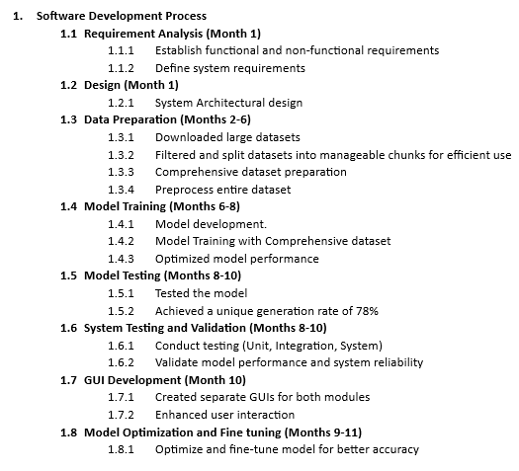
Endeavour

Slide 19
Responsibility Assignment Matrix
WBS # | WBS Deliverable | Activity # | Activity to Complete the Deliverable | Responsible Team Member(s) & Role(s)
1 | Requirements | 1.1 | Hardware Requirements | Osama Khalid
 |  | 1.2 | Software Requirements | Osama Khalid Zeeshan Khan Salman Ali
2 | Phase 1: Develop and Train the AI Model | 2.1 | Research and select appropriate AI algorithms for password analysis. | Osama Khalid Zeeshan Khan Salman Ali
 |  | 2.2 | Acquire or prepare relevant password datasets for training. | Zeeshan Khan Salman Ali
 |  | 2.3 | Train and optimize the chosen AI model with the selected datasets. | Osama Khalid
3 | Phase 2: Implement Core Functionalities | 3.1 | Design and develop functionalities for password strength analysis. | Osama Khalid
 |  | 3.2 | Develop functionalities for automated password cracking (ethical considerations apply). | Osama Khalid
4 | Phase 3: Design and Develop User Interface | 4.1 | Design a user-friendly interface for both offensive and defensive functionalities. | Salman Ali Zeeshan Khan
 |  | 4.2 | Integrate the trained AI model and core functionalities into the graphical user interface. | Osama Khalid
5 | Phase 4: Testing and Refinement | 5.1 | Conduct thorough testing of all functionalities with various password scenarios. | Osama Khalid Salman Ali Zeeshan Khan
 |  | 5.2 | Refine the AI model, graphical user interface, and functionalities based on testing results. | Osama Khalid
 |  | 5.3 | Document user manuals and instructions for the completed tool. | Osama Khalid Zeeshan Khan Salman Ali

Slide 20
PROJECT SCOPE

Slide 21
Project Scope
Defensive capabilities
Password Strength Assessment
Optional: Breach Checking
Offensive capabilities
AI-powered Password Cracking

Slide 22
"Your password is the key to your digital life. Choose it wisely, and guard it fiercely."

Slide 23
PROPOSED SOLUTION

Slide 24
Proposed Solution
Focus cracking efforts on statistically probable password patterns: This reduces the search space and accelerates the cracking process compared to traditional brute-force methods.
Analyze password strength based on complexity metrics and AI-driven pattern recognition: This identifies potential weaknesses in complex passwords, aiding in targeted cracking attempts.

Slide 25
Requirements Summary
Functional Requirements
Unique Password Generation
Password Cracking
Password Strength Analysis
Non-Functional Requirements
Performance
Scalability
Usability
Reliability

Slide 26
Requirements Summary
Hardware Requirements
Workstation:
HP Z840
Processor:
Intel Xeon E5-2680 V4 Dual
Ram:
64 GB DDR4
GPU:
RTX 3070TI 8GB GDDR6x
SSD:
512GB approx
Software Requirements
Operating System:
Win 10/11
Programming Language:
Python 3.12
Visual Studio Installer
SDK
Modules
PyTorch
cuDNN
Etc...

Slide 27
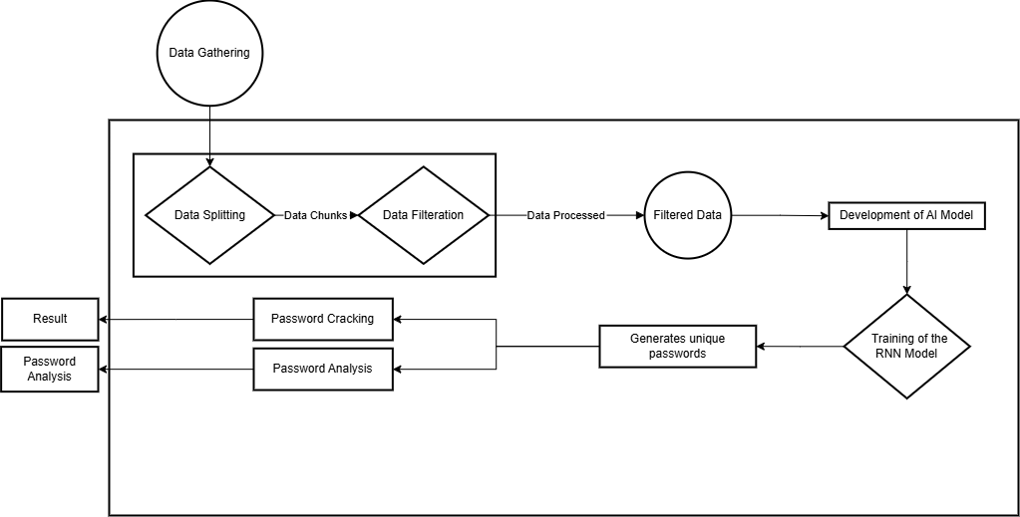
Design Summary

Slide 28
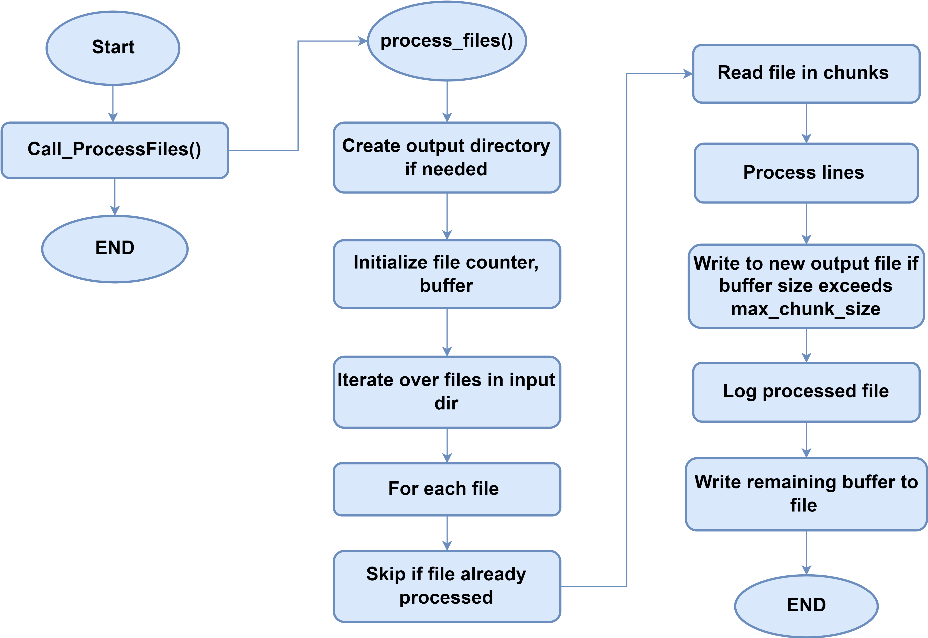
Data Splitting

Slide 29
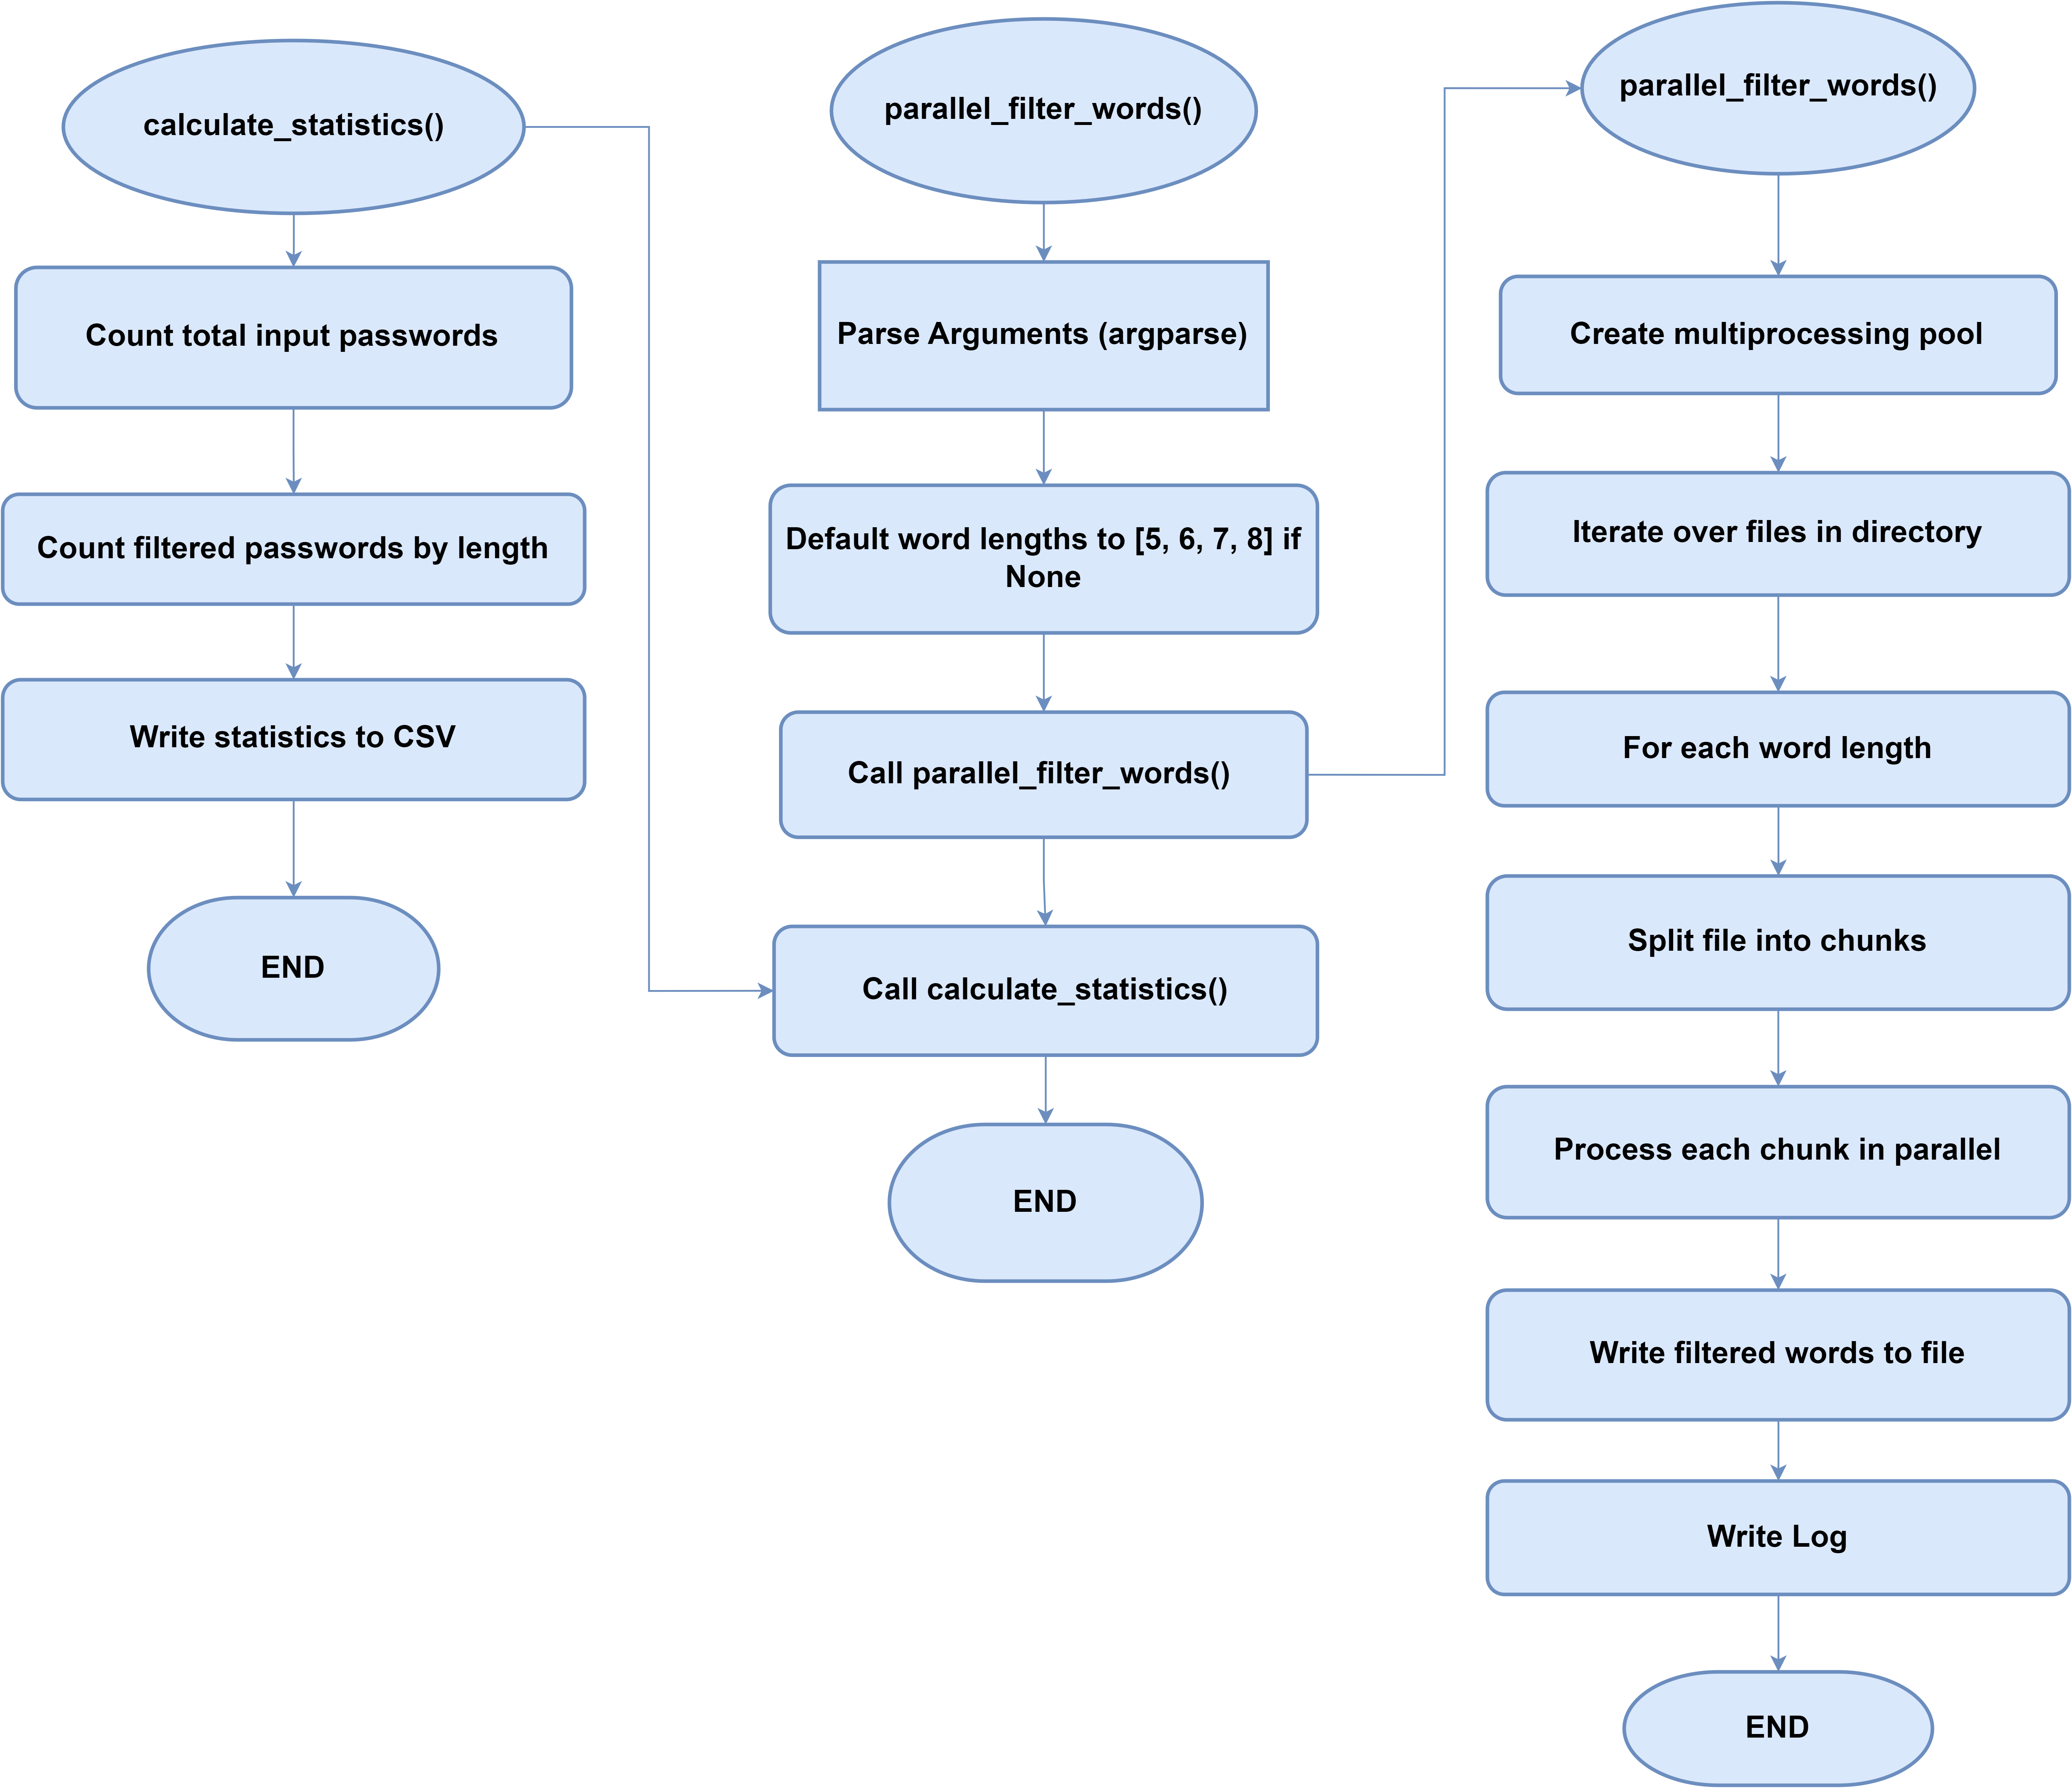
Data Filtration

Slide 30
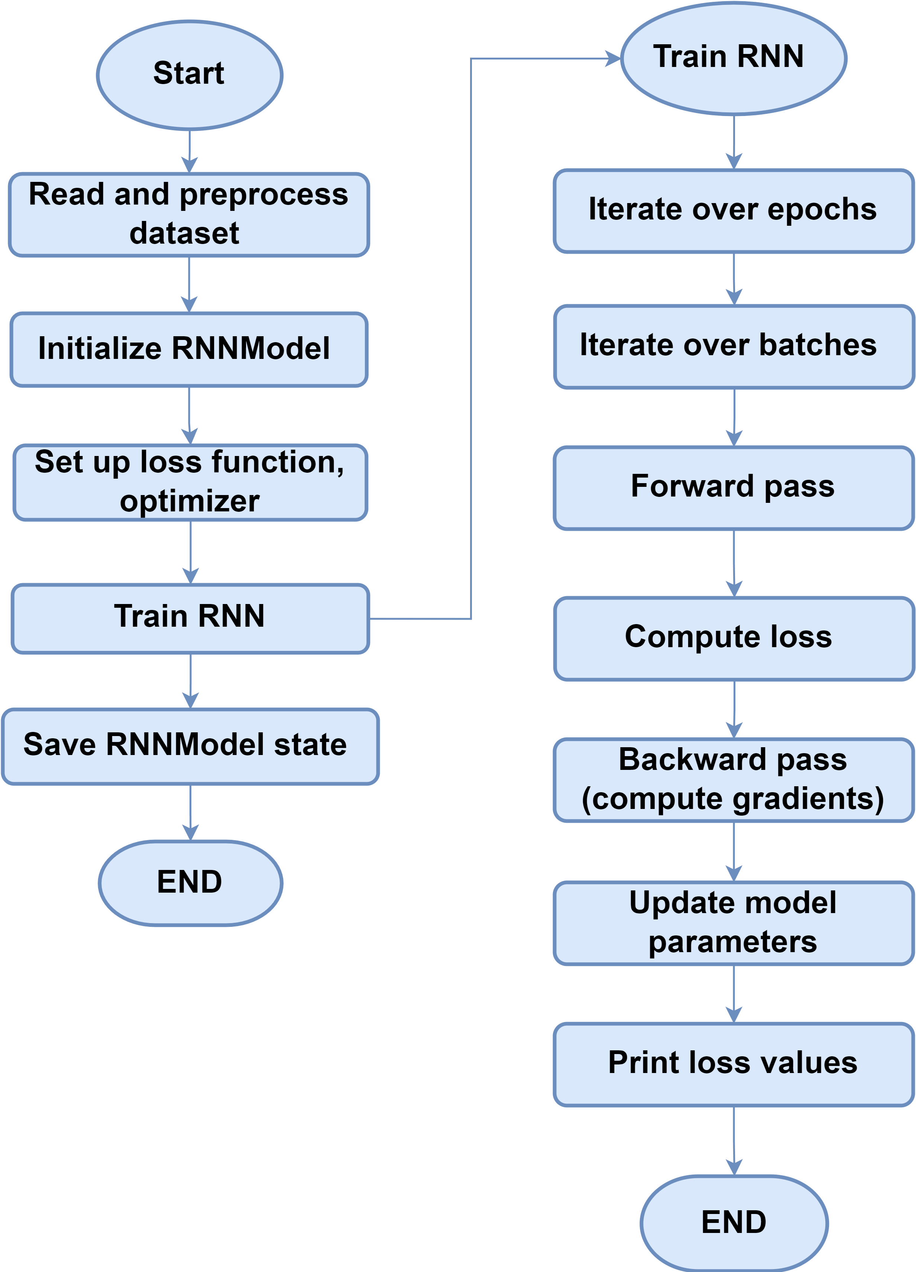
RNN Model Training

Slide 31
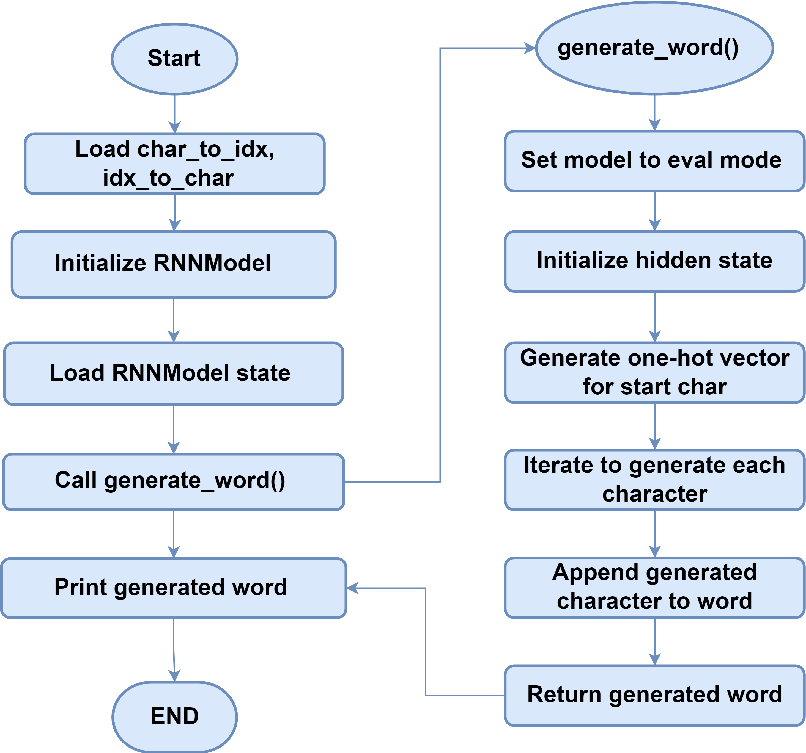
Generating Words through RNN Model

Slide 32
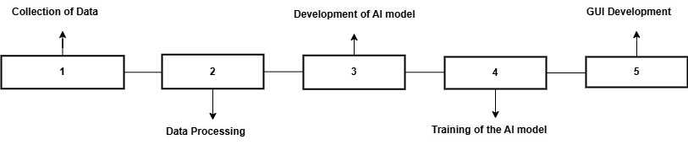
Methodology

Slide 33
Datasets

Slide 34
Data Splitting

Slide 35
Data Filtration

Slide 36
RNN Model Training

Slide 37
Generating Words through RNN Model

Slide 38
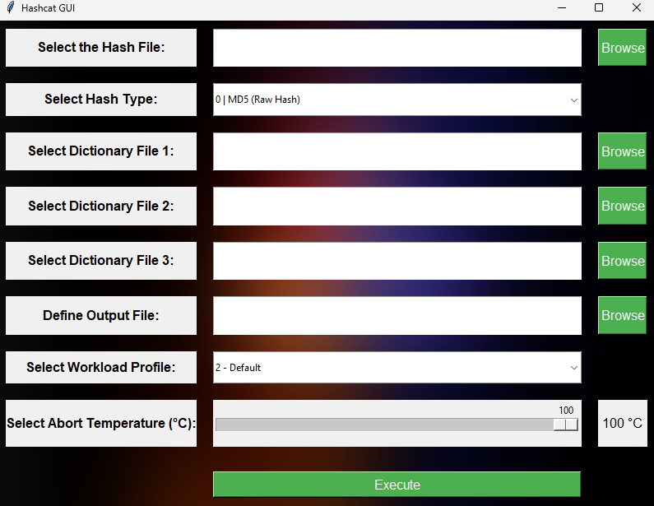
Password Cracking GUI

Slide 39
Key Points
User friendly GUI.
Approx 200 types of hashes can be selected.
Multiple dictionary files can be attached to begin the attack with.
Generates and saves an output file.
Can select the workload.
Temperature control button, when over-heated, process will be aborted.

Slide 40
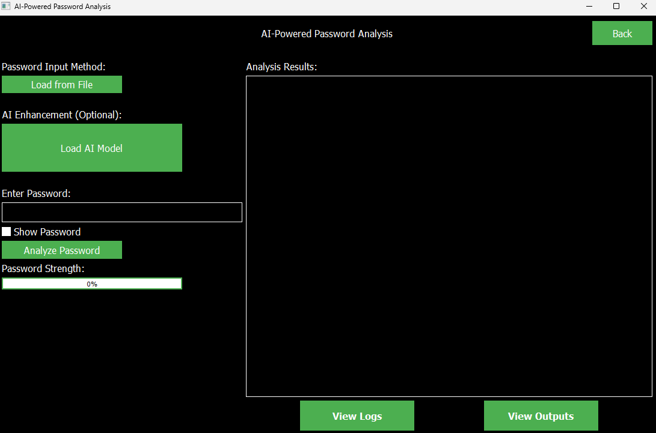
Password Analysis GUI

Slide 41
Key Points
User Friendly GUI.
Can select the newly created file for password analysis.
Generates and saves an output file with detailed info e.g. timestamps, password strength.
Logs are generated too.
Password Strength can be viewed too.

Slide 42
Implementation Summary
Requirement Analysis
Data Splitting and Filtering
System Designing
Development of the AI model
Training of the AI model
Integration of the AI model with Hashcat
Testing of the model on filtered data
GUI creation

Slide 43
Experiments & Results Summary
Metric | Value
Total Words | 3,204,831
Unique Words | 2,498,318
Avg Word Length | 8.0000
Std Word Length | 0.0000
Unique Chars | 110

Slide 44
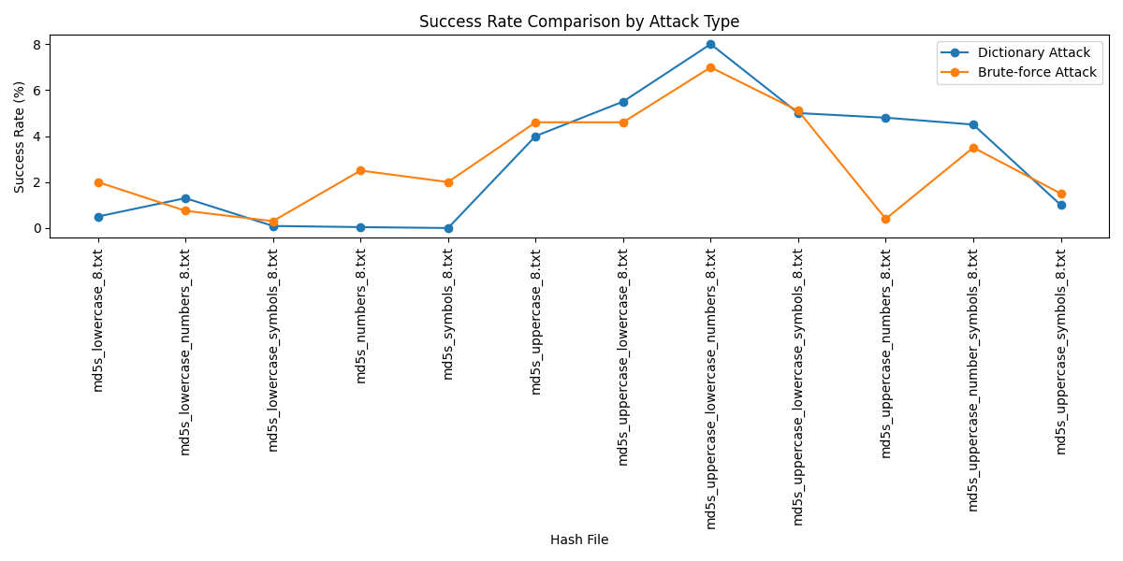
Testing Summary

Slide 45
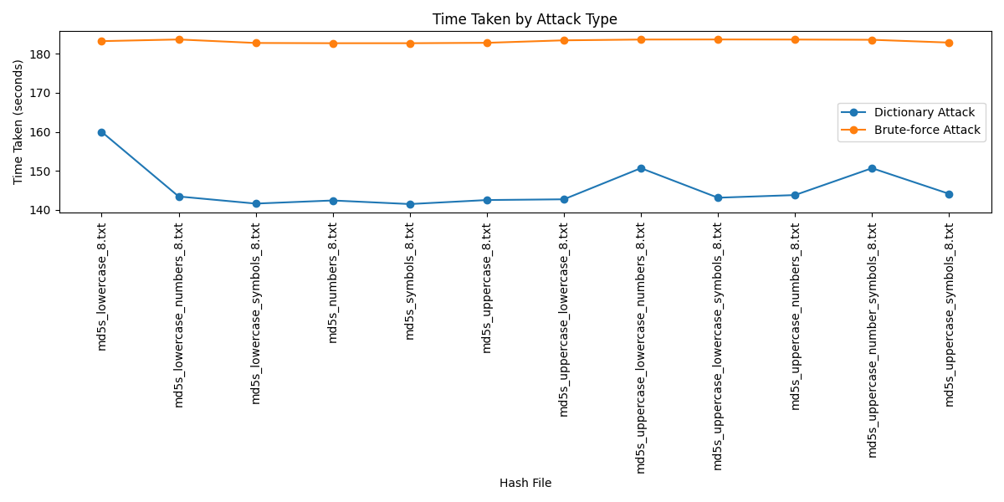
Testing Summary

Slide 46
CONCLUSION & OUTLOOK

Slide 47
Conclusion
Password Cracking
Password Analysis
User-Friendly GUI

Slide 48
Outlook
Continuous Enhancement
Distributed Network Implementation
Promoting Responsible Use

Slide 49
THANK YOU!

